Slide 1

Optimising Code Using CodeScape
Steve Ramm
Product Development Manager
Cross Products Limited

Slide 2
Optimising with CodeScape
Statistical Profiling
Trace Profiling
  - Point-to-point timing
Link Order Optimisation
Pipeline Simulation

Slide 3
Statistical Profiling
Sampling rates from 1Hz to 1kHz
Negligible effect on running program
Addresses with no debug information recorded under ‘OTHER FUNCTIONS’
Notes:
Statistical Profiling will obtain the Program Counter (P.C.) during execution at a rate of 1 to 1Khz. From this P.C. the Profiler can deduce which function it is in. The number of times a function is ‘Hit’ is recorded along with the number of ‘Hits’ at that specific address.
The Profiler will display the function names along with a total of Hits. The number of Hits per address or source line is displayed in the disassembly and source window respectively. For statistical profiling, the number of hits a function has is directly proportional to the time spent in that function. Note that statistical profiling does not guarantee to record a hit on every function that is called. It is best to perform statistical profiling over a long period of time, and to choose a sampling frequency that is unrelated to any frequency in your target system. If you suspect there may be some ‘beating’, then run again with another unrelated frequency and compare the profile outputs.
The Profiler will indicate ‘Hot Spots’ with an icon. A Hot Spot is an area of code which is executed most frequently. The threshold to define a Hot Spot is user definable.
The Profiler updates during profiling so you don’t have to wait until you have stopped before analyzing the results.
*The greatest advantage of Statistical profiling over Trace Profiling is that there is negligible effect on execution of the application.
* If there is no debug information about a particular Program Counter address then the profiler can do nothing else but record this ‘Hit’ under the title of ‘OTHER FUNCTIONS’.
* So it is important for statistical profiling that you have as much debug info as possible. The debug information comes from the .elf or .cof file. If you are using the Hitachi tool chain, then tick the box in the load program file dialog to use the link map file to get extra information.

Slide 4
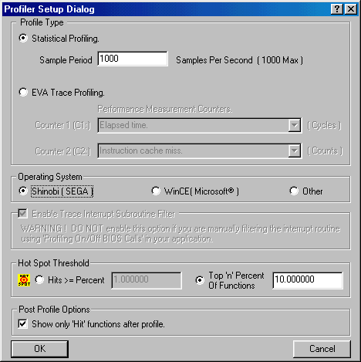
Statistical Profiling
Notes:
Select Tools|profiler from the menu. There is a delay while the profiler assimilates the debug information, then this dialog will appear. To get to this dialog at any other time, right-click the profiler and select ‘Setup..’ from the menu.
Select Statistical profiling and enter the number of samples per second required.
*The Operating System and Trace Interrupt Subroutine Filter is used for Trace profiling only
*Define the Hot Spot threshold so that functions are flagged as hot spots because they have more than a certain percentage of hits, or because they are in the top so many percent of called functions.
*Post Profile options – if the box is ticked only functions that have been ‘hit’ will be displayed in the list after profiling.

Slide 5
Trace Profiling
Uses SH4 Hardware features
  Trace buffer
  Performance counters
Information displayed in two ways
  List of functions with accumulated totals
  Call tree with individual measurements for each unique call path
Notes:
The Trace buffer, part of the SH4 hardware, records the value of the PC at calls to and returns from Functions (JSR, BSR, BSRF, RTS), Interrupts, and Exceptions (RTE).
The performance counters can record two from a list of 33 different items including such things as elapsed time, number of instruction cache misses, pipeline freezes, etc.
The profiler will display either a list of the functions with the number of hits and the accumulated totals for the performance counter measurements, or the data may be displayed as a call tree with the data for each unique call path, in the latter case a function may appear more than once if it is called from different functions.

Slide 6
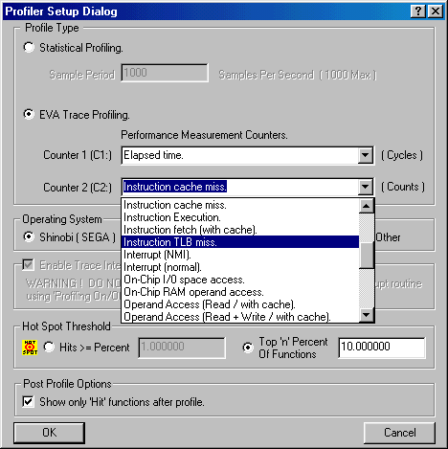
Trace Profiling
Notes:
In the profiler setup dialog choose Trace profling, then:
Select the parameters that are to be measured with the performance counters.
If your application uses the performance counters, the profiler may not function correctly. However, you may tell the profiler not to use one of the counters by selecting “* Ignore Counter” from the drop-down list.
Select the Operating system that you are using. I’ll tell you about the Trace interrupt subroutine filter later.
Select the Hot spot threshold and the post profile options just as for Statistical profiling.

Slide 7
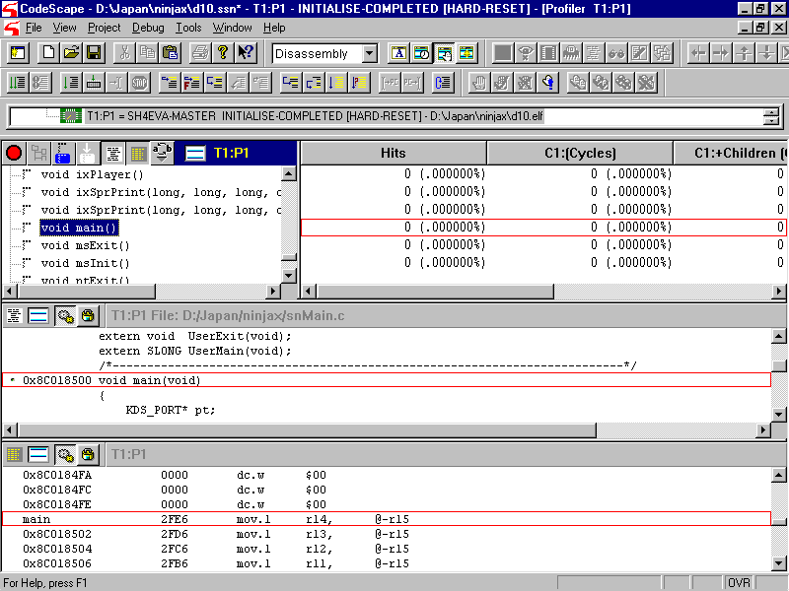
Profiler List Display
Notes:
This is the profiler window. At the top left is the function region, here showing the flat list display. After trace profiling a tree display is also available, which I will show later. When the profiler starts the function list is filled with all the symbols available from the debug information. A given function can be found just be starting to type the function name. Functions can be tagged and there is a “go to the next tagged function” option.
At the top right is the data region, where the number of hits and, for trace profiling, the accumulated totals of the performance counters, are shown. The data region may be sorted on any column by clicking on the header in the usual way. The columns show for each function entry the number of hits, and the accumulated totals of the performance counters for that function (C1 and C2), and for that function and all the functions it calls (eg C1+children).
At the bottom are the source and disassembly regions which may be turned on and off using buttons in the function region, or the right-click menu. These are like the normal source and disassembly regions in CodeScape except that they are synchronised to the profiler. Clicking on a function in the function window will cause that location to be displayed in the source and disassembly windows, and setting a breakpoint in either window will automatically configure it as a profiler start or stop breakpoint.

Slide 8
Profiler Breakpoints
It’s easiest to set the breakpoints from the profiler
There is only one start breakpoint
There can be multiple stop breakpoints
Profiler breakpoints don’t stop the target program
One pass between breakpoints is possible
  - Allows point-to-point timing
Instruction order may be confusing
Notes:
Although you can configure any code breakpoint to be a start or stop profiler breakpoint using the breakpoint configuration dialogue, the easiest way to to set the breakpoint (press F5) from a profiler source or disassembly region. If you do that, it will be automatically configured as either a start or a stop breakpoint. The first will be considered to be the start breakpoint (you can have only one), and subsequent breakpoints will be configured to be stop breakpoints.
Profiler breakpoints don’t halt your program on the target system; the breakpoint goes off, CodeScape starts or stops the profiler, and then resumes running the program. You can use this feature to profile just one function that is called many times in the operation of your program. It is possible to profile just one call of a function or one pass of a section of code; select ‘one pass between breakpoints’ from the right-click menu of the function or data region.
This feature allows you to collect timing or other information between any two points in your program.
Finally, instruction order may be confusing. Because of the nature of for example ‘for’ loops, or because of optimisation, apparently sequential sections of C code may generate sections of assembly code in a different order. For this reason it is possible to set a start breakpoint followed by a stop breakpoint in the disassembler region, but in the source region the stop appears before the start. In these cases the disassembly region shows the true order, and it’s a good idea always to check the disassembly region after you’ve placed your breakpoints using the source code window. You never know what code reordering the compiler might do.

Slide 9
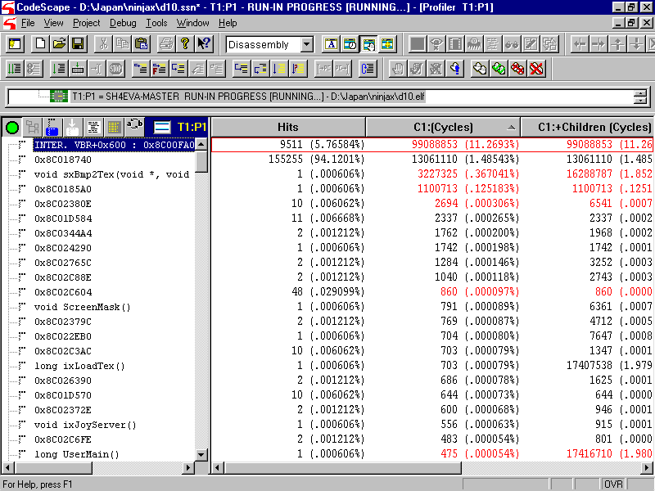
During profiling
Notes:
During profiling the Function List Display is regularly updated, when the buffer in the Debug Adapter becomes full. This means that you get profiling information during execution.

Slide 10
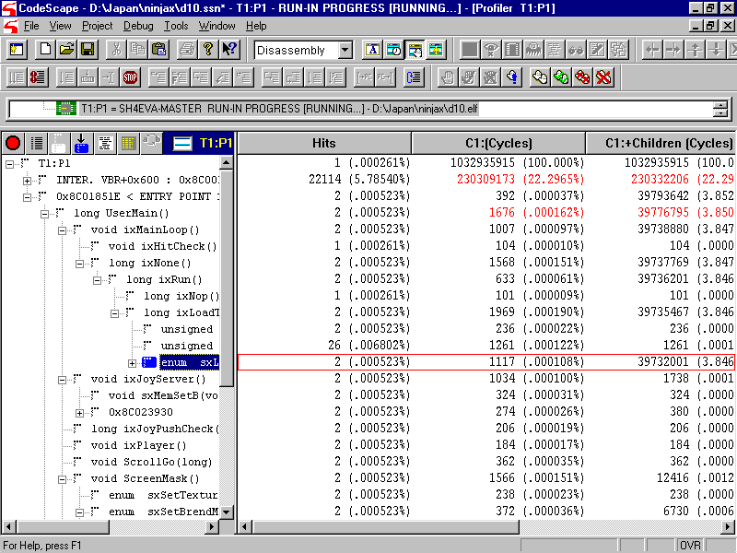
Call Tree Display
Notes:
The profiler Tree Display in the function region shows:
The target and processor ID as its root
The next level shows tasks and interrupts
After that are shown the functions called in the task or interrupt
The profiler automatically detects context switches, I.e. task swaps, interrupts, and exceptions
A Tagged function is shown. Tag a function at any time by double clicking on it. You can then:
- use the ‘goto next tag’ function to jump through the tree to the functions you have tagged
- us the function display filter to show only those functions that you have tagged

Slide 11
Interrupt Problems
‘Interrupt Lock-up’
  Code runs slower but interrupts occur at the same rate
Interrupt trace subroutine filter
  Stops profiling during interrupts
Profiler on/off BIOS calls
  Integrated into Shinobi Library
Notes:
Interrupt lock-up. The profiler causes the target application to run slowly because of the time taken to record and download the information to CodeScape. However, timer-based interrupts still occur at the same rate. If the profiler slows the interrupt code sufficiently, the application can spend all of it’s time in interrupts and no time in the background task. Because of this we have:
The Interrupt trace subroutine filter. If this feature is enabled, then subroutines called by the interrupt routine will not be profiled. This speeds up the interrupt routine to try and combat interrupt lock-up. However, it can still occur if the interrupt timing is such that the amount of time taken to turn the profiling off at interrupt and on again at return from interrupt is sufficient to push it over the edge.
Profiler on/off BIOS calls. Another way of disabling profiling during interrupts, or anywhere for that matter, is to use the special profiler on/off BIOS calls within the debug build of your code. These have already been integrated into the Shinobi library where they can be activated by CodeScape.

Slide 12
Other profiling Caveats
Code Optimisations
  In-lined functions
Incorrect Counter Data
  SH4 pipeline anomalies
Performance Counters
  Target program uses the performance counters
Notes:
Code Optimisations such as in-lining functions cannot be profiled. The Trace profiler detects events such as JSR and RTS – if these don’t happen it doesn’t ‘see’ the function, in which case all the time or other performance counter data will be attributed to the calling function. Notes that individual in-line functions can still be profiled by placing the profiler start and stop breakpoints in the function body.
Incorrect counter data. Sometimes the SH4 only produces one notification for two branches. This may occur for example if an interrupt is acknowledged directly after a branch. In this situation the debug adapter has both addresses but only one set of performance counter data, and doesn’t know how much data is attributable to which event. CodeScape highlights such data in red.
Performance counters. As the profiler uses both performance counters, using them in your application will present problems to both your application and the profiler. However, you can prevent the profiler from using one of them in the setup dialogue, allowing one to be used by your application and the other by the profiler.

Slide 13
Operation Using Breakpoints
Load the program
Start and configure the profiler
Set start and stop breakpoints
Enable the profiler
RUN
Disable the profiler
Examine the output
Notes:
This is the preferred method of using the profiler, and the ONLY method that will get correct results if you are using the Shinobi library, because CodeScape uses the Profiler start breakpoint to insert patches into the interrupt code.

Slide 14
Operation Without Breakpoints
Load the program
Start and configure the profiler
Run to where you wish
Enable the profiler
RUN
Disable the profiler
Examine the output
Notes:
Reiterating an important note:
If you are using the Shinobi library, then you MUST have a profiler start breakpoint. This is because the interrupts of Shinobi library must be patched at the start of profiling to ensure correct results, and this is done automatically by CodeScape when it encounters the profiler start breakpoint.

Slide 15
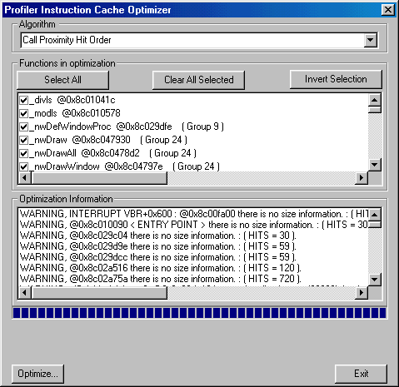
Link Order Optimisation
Notes:
Instruction Cache Optimizer…
*This is a very important optimization on the SH series of processors. An instruction cache miss is usually 25 to 30 times slower than an instruction cache hit.
First you need to Trace Profile your application.
Then Select Optimize from the Profilers menu and the above dialog will appear.
Press the optimize button and the profiler will produce a .LOR file.
The .LOR is a text format file which contains an optimal link order for your application, based upon the profile data that you collected.
This file can be input to the linker which will automatically re-link your application and optimize your instruction cache. Currently this feature is available only with the Metrowerks linker; it will soon also be available for Hitachi.
The file is also readable to the eye so it is possible to use as a guide for manually re-linking your application.

Slide 16
Simulator
Purpose:
  As an aid in reducing pipeline stalls in small sections of heavily used code
Notes:
Included in CodeScape is a cycle accurate pipeline simulator for the SH4. The purpose of this is as an aid in reducing pipeline stalls in small sections of heavily used code.
By small sections I mean no more than one page of simulator output, any more than this is too much. I assume that it is hand-coded assembler which you wish to optimise. Such routines may include
Matrix multiplication
Transformations
Other calculations that need to be lightening-fast.

Slide 17
Architecture
The model is based around
  Dual issue superscalar architecture.
    Multiple pipelines.
  8Kbytes Instruction Cache.
  16Kbytes Data Cache.
  Store Queues
Notes:
Our simulator model is based around the SH4 used in Dreamcast, I.e. A dual issue superscalar architecture with multiple pipelines. That is to say, where possible the SH4 will execute two instructions at once, and we simulate this feature along with the multiple pipelines involved. We also simulate the 8Kbytes of Instruction cache, the 16Kbytes of data cache, and the Store Queues.

Slide 18
Dual Instruction Dispatch
Instruction Classification
  6 instruction Groups
  MT
  BR
  FE
  EX
  LS
  CO
Notes:
Maintaining dual issue is one of the aims for efficient code on the SH4 CPU. If the CPU cannot execute two instructions at once, then effectively its speed if halved. There are many things which affect whether instructions can be executed together, and to simplify the rules instructions can be classified into 6 groups:
MT – Compare, test and register to register moves
EX – Logic and arithmetic
BR – Relative branch instructions (BF, BF/S, BT, BT/S, BRA, BSR)
LS – Mostly floating point instructions and moves between memory and register
FE – Floating point instructions
CO – Mostly control instructions

Slide 19
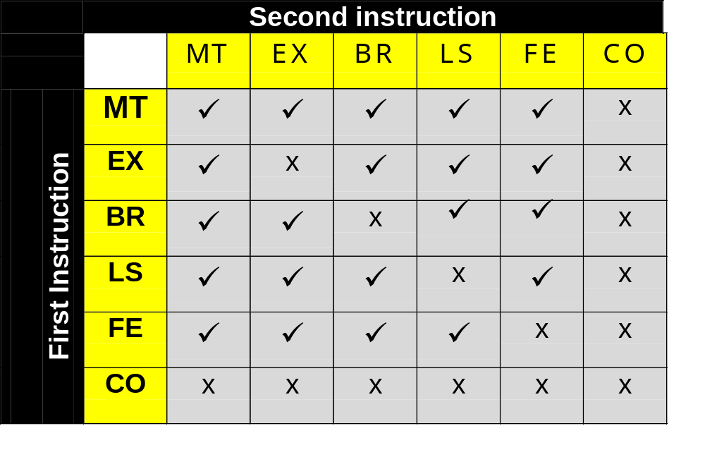
Dual Dispatch
Possibilities
Notes:
Combinations of op-codes that are marked with a tick can be dispatched together effectively doubling the throughput of the processor. As you can see, there are two rules:
Only instructions in the MT group can be executed with another instruction of the same group
Instructions in the CO group can only be executed alone
Otherwise, an instruction in one group may be executed at the same time as an instruction from another group, provided that there is no other reason that causes a pipeline stall.
Code reorganization can help performance dramatically by reducing the number of pipeline stalls.

Slide 20
Examples
Will Dual Issue
a) mov.l @r3, r7 ;(LS)
add r5, r4 ;(EX)
b) clrt ;(MT)
mov r3, r5 ;(MT)
Will Not Dual Issue
a) mov.l @r3, r7 ;(LS)
mov.l @r3, r7 ;(LS)
b) add r5, r4 ;(EX)
ldc r9, gbr ;(CO)
Notes:
Here are a couple of examples of instructions that can be executed at once because they are in compatible groups.
And here are a couple of examples of instructions that won’t dual issue because that are in incompatible groups.

Slide 21
Resource Dependency
Register Usage
  mov.l @r3, r4 ; (LS)
  add r5, r4 ; (EX)
  Prevents multiple dispatch even though the instructions are in compatible groups.
Notes:
Large numbers of cycles can be lost by ignoring resource dependencies.
The depth of the pipeline can cause resource dependency to impact much later in the code.
Code reorganization can help performance dramatically.

Slide 22
Memory / Cache
We Simulate:
  Instruction Cache.
  Data Cache:
    Copy-Back or Write-Through Mode.
    Split Data Cache in to On-Chip Ram
Notes:
This is what we simulate of the cache

Slide 23
Memory / Cache Initialization
  Initialized on startup from the processor cache.
  Memory access timings defined in DALI.CFG
Notes:
When we simulate the cache, it is only of any use if it reflects the state of the cache at the time we start simulating. For this reason, when the simulator is used the simulated cache is initialised with the true state of the processor’s cache. During simulation, any actual memory accesses are performed by writing to and reading from the actual memory of the target system, and the timings recorded for these accesses are calculated using memory timing information from the CodeScape configuration file DALI.CFG.

Slide 24
Store Queues
Two independent 32byte storage areas.
Features modeled:
  Control register.
  Writes performed via Pref @Rn
Notes:
We also simulate the store queues, including the control register and any writes performed using the PREF instruction.

Slide 25
User Interface
Reading the output
  Time measure horizontally as slots.
  All stages accessed in a slot are considered to act concurrently.
  The pipeline stalls when there aren’t enough resources to do operations concurrently.
Source / Disassembly Tracking.
Notes:
For each instruction time moves horizontally
Concurrent operations in the same slot are shown vertically
Pipeline stalls are shown in red
A source or disassembly window will track the simulated PC just as when using the real processor, but because of the pipelining and the fact that the simulated processor is always part of the way through at least one instruction, the pointer in the disassembly window may appear sometimes to be out by one address. In fact the pointer in the disassembly window usually points to an instruction that is in the instruction decode phase, but this can be obscured by a pipeline stall.

Slide 26
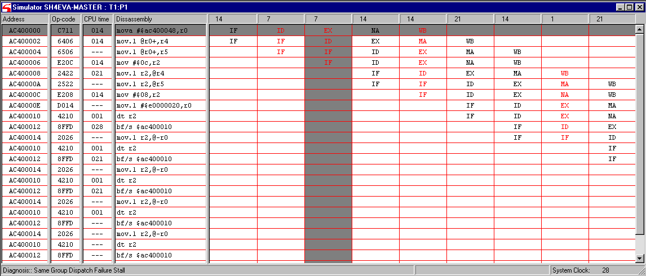
Simulator Output
Notes:
Here is a simulator window showing some instructions, with four pipeline stalls visible. This isn’t a very exciting example and in fact there is a much better one in the simulator manual. But I can use this to show you around.
At the left, the address of the instruction, the op-code, and the time taken to execute the instruction, measured between the execution phase of one instruction and the next. If instructions are successfully dual-issued, then the time for both is attributed to the first instruction. In the next column is the disassembly of the op-code, and the reset of the display is taken up with the slots. The figure at the top of each slot is the time each slot took, which is the time of the longest of the concurrent pipeline phases. For example, you can see a column headed up ‘1’, where all the stages took only one clock cycle, whereas the column headed ’21’ included memory accesses which took much longer. The highlighted instruction is shown with all it’s slots highlighted horizontally, and the stages of other instructions concurrent with the execution phase are highlighted vertically.
The stage is described in each slot:
IF – Instruction fetch
ID – Instruction decode – can have two operating concurrently
EX– Execute phase – also there can be two of these
SX – Different sort of instruction phase (not shown)
MA – Memory access
NA – No access ( a memory access slot that doesn’t access memory)
WB – Write back phase (to register). Actually a lot of SH4 instructions write back to register earlier, in the execution phase, but the architecture means that all instructions must end with write back.
Floating point operations can have multiple execution phases starting with F0 or F1 and continuing through F2 or F3
FS (not shown) is a Floating point store phase.
At the bottom left we can see a diagnosis of the current pipeline stall, I.e. the one in the highlighted slot; it stalled at the instruction decode phase of the because the instructions at addresses AC40002 and AC40004 are both in the LS group.
At the bottom right is the total number of cpu clocks from the start of the simulation to the end of the highlighted slot.

Slide 27
Current Limitations
Interrupts disabled.
MMU not modeled.
Changes to CCR only 32bit writes.
No on-chip peripherals modelled.
  Timers, PCMCIA, etc.
Unsupported Op-codes:
  SLEEP
  LDTLB
Notes:
As a general point:
The processor and pipeline model is very good
The memory model is dubious but good enough that optimisations made with the simulator will yield genuine improvements.
The peripheral timing model, however, is wrong.
Despite these limitations, the simulator is an extremely powerful tool when used for what it is intended, I.e. for optimising small heavily-used sections of hand-written assembly code by reducing the number of pipeline stalls.

Slide 28
CodeScape
        Any Questions?
Notes:
We have a couple of engineers in the other room here with development kit who will be able to answer complicated questions and give some demonstrations

